Slide 1

Spelling, Numbers & Grammar Traps | Don’t Lose Easy Listening Points
Notes:
Many IELTS candidates feel frustrated after the Listening test because they say, "I understood the audio perfectly… so why is my answer wrong?"
The truth is, in IELTS Listening, understanding alone is not enough. Accuracy is equally important.
Even very small mistakes can cost you marks. For example:
A spelling error
Writing a singular noun instead of plural
Incorrect capitalization when required
Writing a number in the wrong format
Exceeding the word limit
These may seem minor, but in the IELTS Listening test, answers are marked as either correct or incorrect. There is no partial credit.
Today, we are going to focus on the most common traps that cause students to lose easy points.
“Hello, my name is April Ampong, and I’m an instructor at IELTS NINER REVIEW CENTER— an international-standard IELTS training system that helps learners progress from beginner level to Band 7.0–9.0 in the most time-efficient way.”
“In the previous video, we learned how to handle paraphrasing in IELTS Listening.”
“Now we’ll focus on what often goes wrong after you’ve found the correct answer.”

Slide 2
Spelling Traps
Spelling is one of the biggest reasons correct answers become incorrect.
Common Problems:
Missing or extra letters (enviroment VS environment; accomodation instead of accommodation)
Confusing similar sounds (their and there, or price and prize)
British vs American spelling
IELTS accepts both British and American spelling—but you must be consistent and accurate.
Example: colour or color, centre or center
If the spelling is wrong, the answer is wrong—even if the meaning is correct.
Notes:
Now, let’s talk about spelling, which is one of the biggest reasons correct answers become incorrect in the IELTS Listening test.
Many students lose marks not because they misunderstood the recording, but because they wrote the word incorrectly.
Some of the most common spelling problems include:
• Missing letters — • Extra letters — • Confusing similar sounds — • Mishearing vowel sounds —
• British versus American spelling differences
Now, regarding British and American spelling: IELTS accepts both. You can write colour or color, centre or center. However, your spelling must be accurate. If you choose American spelling, make sure it is spelled correctly. If you choose British spelling, make sure that is also correct.
Consistency is also important. Avoid mixing spelling styles randomly within the same test.
Remember this key rule: If the spelling is wrong, the answer is wrong — even if the meaning is correct.
The examiner does not judge your intention. The marking is precise and objective. That is why developing strong spelling accuracy is essential if you want to protect your band score.

Slide 3
Number Traps
Numbers are another major source of lost points
Be careful with:
Dates
Prices
Phone numbers
Times and durations”
For example: fifteen vs fifty fourteen’ vs ‘forty
Always listen for stress and pronunciation, especially in fast speech.
Notes:
Let’s now move on to another common problem area in IELTS Listening: numbers.
Numbers are a major source of lost points. Many candidates understand the context perfectly, but they mishear or miswrite a number — and that single mistake costs them a mark.
You need to be especially careful with:
• Dates • Prices • Phone numbers • Times • Durations
Each of these appears frequently in Sections 1 and 2 of the Listening test.
One of the most common traps involves similar-sounding numbers, such as:
• fifteen versus fifty • fourteen versus forty • thirteen versus thirty
The difference is often in the stress and pronunciation.
For example:
In fifTEEN, the stress is on the second syllable.
In FIFty, the stress is on the first syllable.
In fast speech, this difference can be subtle, so you must train your ear to notice it.
Also, pay attention to how numbers are grouped. For example, phone numbers are often divided into pairs or small groups. Dates may be spoken in different formats, such as “the 15th of March” or “March fifteenth.” Prices may include decimals, such as “sixteen point five zero.”
Another important tip: always write numbers in the format required by the instructions. If the form asks for words, do not write digits. If digits are allowed, use them carefully and clearly.
During the test, stay calm and focused when you hear numbers. They are often repeated, but sometimes they are corrected — which means you must listen until the speaker finishes.
Remember, numbers are not difficult — but they require careful attention.

Slide 4
Grammar Traps (Singular & Plural)
Pay close attention to:
Singular vs plural nouns
Articles like a and an
Verb forms
If the question requires a plural noun and you write a singular form, the answer is marked wrong.
Grammar is part of accuracy.
Notes:
When answering questions, you need to pay close attention to grammar — not just meaning.
There are three key things to focus on: singular and plural nouns, articles like a and an, and correct verb forms.
First, check if the answer should be singular or plural. If the question requires a plural noun and you write a singular form, it will be marked wrong — even if your idea is correct.
Next, don’t forget articles. Using a or an incorrectly, or missing them completely, can cost you marks.
Also, pay attention to verb forms. Make sure your verbs match the subject and are in the correct tense.
Remember, grammar is part of accuracy. Even small mistakes can make your answer incorrect.
So always take a moment to check your grammar before finalizing your answer.

Slide 5
Instructions Are Part of the Test
Many candidates lose points because they ignore instructions.
For example: NO MORE THAN TWO WORDS AND/OR A NUMBER
If you write three words—even if they are correct—you lose the mark.
Always read the instructions carefully before listening.
Notes:
Many candidates lose points simply because they ignore the instructions.
For example, you might see a direction like: “No more than two words and/or a number.”
This means your answer must follow that exact limit. If you write three words — even if they are correct — you will lose the mark.
So it’s not just about understanding the answer, it’s also about following the rules.
Always take a moment to read the instructions carefully before the audio starts.
This small step can help you avoid unnecessary mistakes and improve your overall score.

Slide 6
Advice from IELTS NINER REVIEW CENTER
At IELTS NINER REVIEW CENTER, we train students to:
Check spelling
Count words carefully
Review /singular/ plural forms
These habits protect your score.
Notes:
First, check spelling after writing an answer. Even a small spelling mistake can cost you a point.
Second, count words carefully. Always make sure answer follows the word limit given in the instructions.
Finally, use the last few seconds to review plural forms. Check if the noun should be singular or plural before time runs out.
These simple habits can make a big difference. They help protect your score and reduce avoidable mistakes.

Slide 7
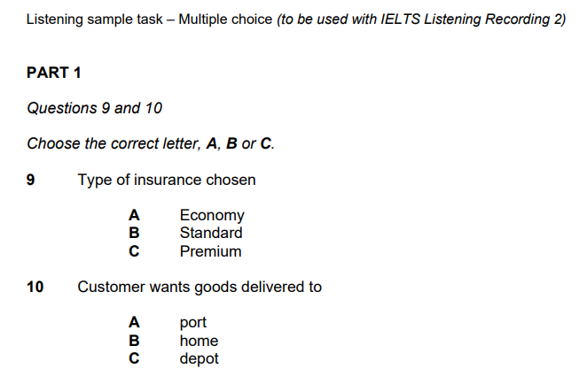
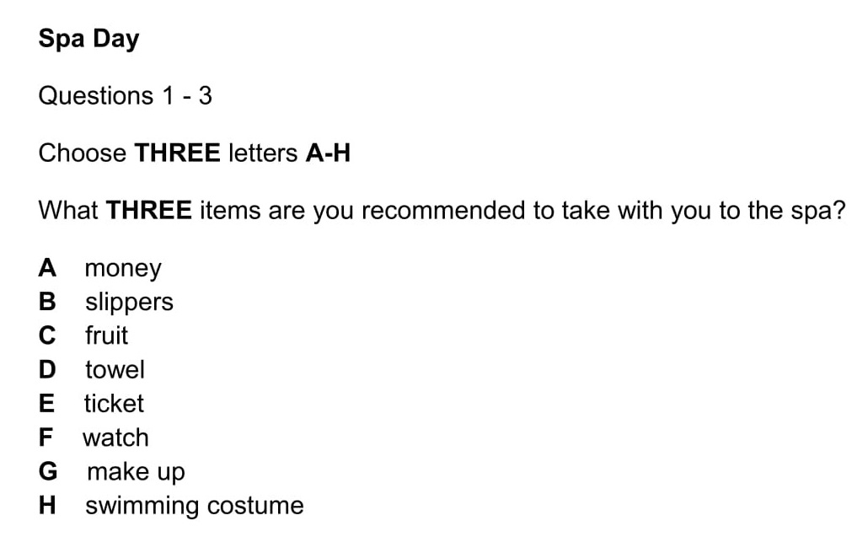
Notes:
“Now that you know how to avoid these traps, it’s time to focus on specific question types.”
“In the next video, we’ll break down: 👉 Multiple Choice questions in IELTS Listening—and how to eliminate wrong options quickly.”
“See you in the next video.”

Slide 8
Add a Slide Title - 3

Slide 9
Add a Slide Title - 4

Slide 11
Add a Slide Title - 5

